Slide 1
AI Your New Employee

Slide 2
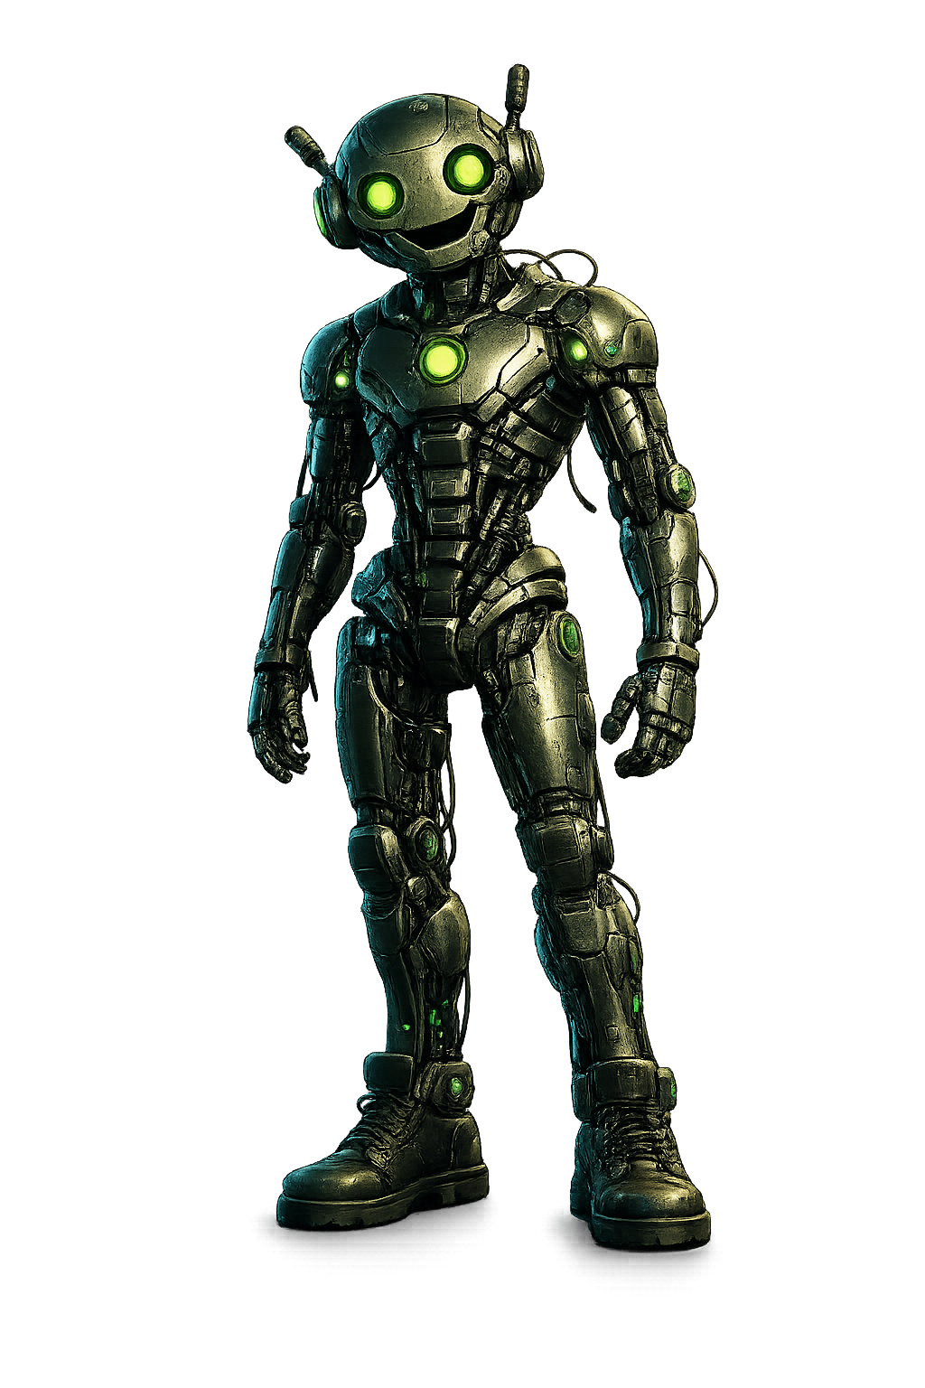

Skilled
Competent
Intelligent
Useless

Slide 3
Learn

Slide 4
Amnesia

Slide 5
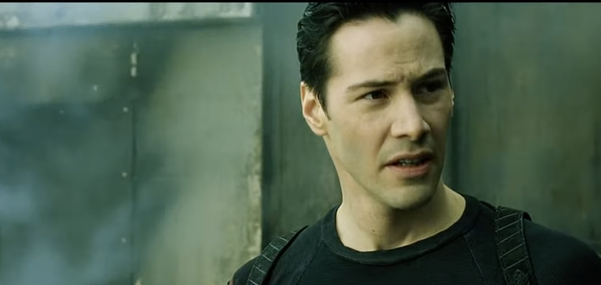
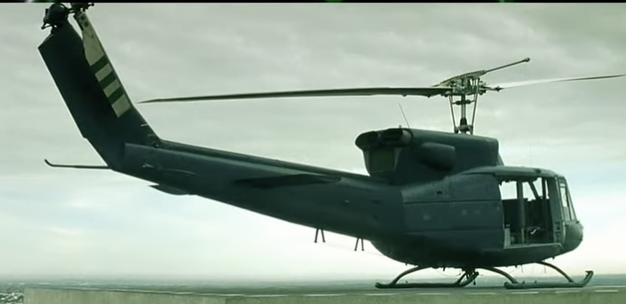
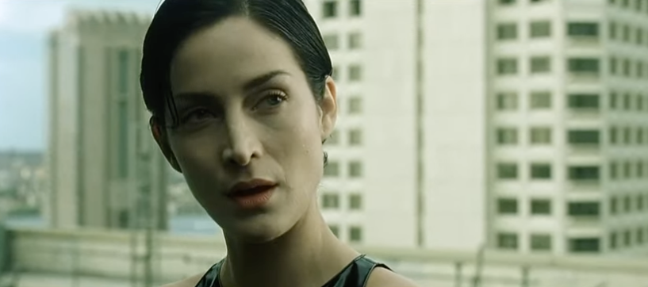
Can you fly that thing?
Not yet…

Slide 6
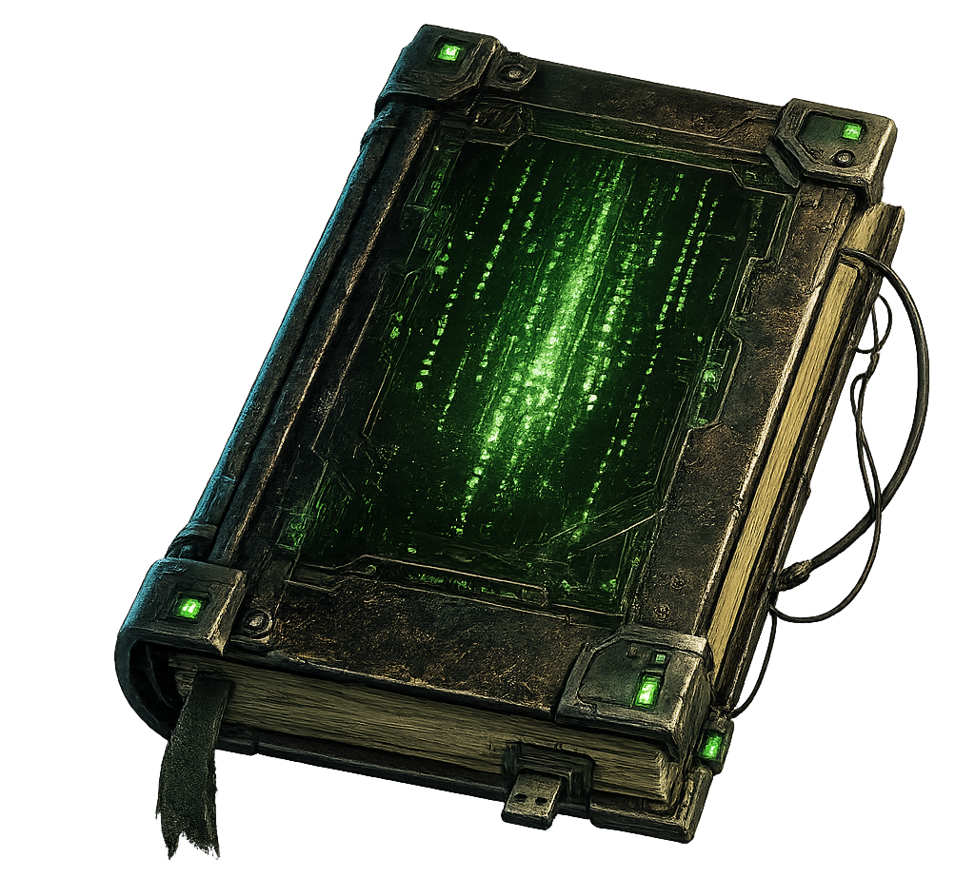
f
e
a
t
u
r
e
d
e
s
c
r
i
p
t
i
o
n
p
r
o
j
e
c
t
m
a
p
Knowledge Documents
p
r
o
c
e
s
s
f
i
l
e
A G
E
N
T S
.
m
d
S
K
I
L
L
S

Slide 7

You are the operator

Slide 8
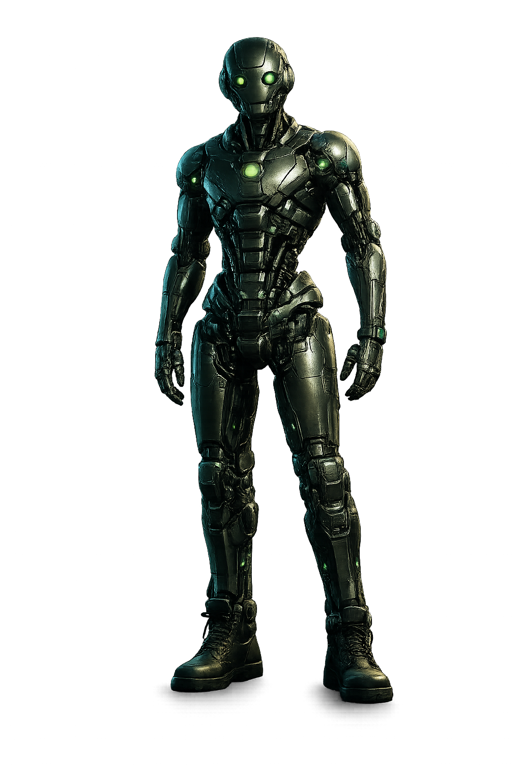
Knowledge
Documents

Slide 9

Thank YOU (please connect via LinkedIn and Twitter)
@LlewellynFalco
youtube.com/isidoreus
LlewellynFalco.Blogspot.com approvaltests.com

